Slide 1
Third-party Lending: An Introduction for Habitat Affiliates
March 11, 2026

Slide 2
  Who We Are

Slide 3

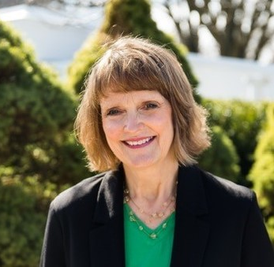
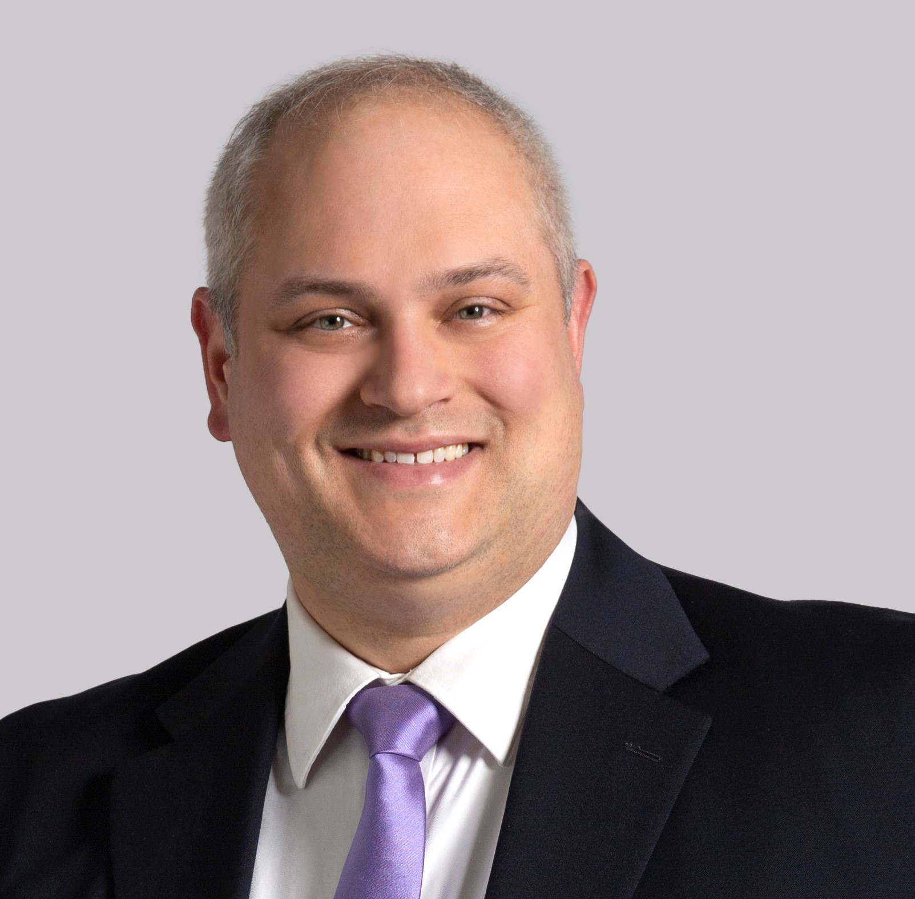
Sarah Brachle Wagner Dru Bergman Peter Lewandowski
Chief Executive Officer Dir Financing & Gov Grants Chief Executive Officer
Chicagoland Habitat Chicagoland Habitat Habitat for Humanity
for Humanity for Humanity Wisconsin
Notes:
Speakers on the call today, and the drivers behind this program on the Habitat side. Dru and I w/CHFH, Dru lead on this program.

Slide 4

Affiliate Support Organization serving the 5 Habitat affiliates in the Chicago metro area:
Help raise awareness
Support capacity building
Provide resources
Engage with affiliates in regional creative problem-solving to serve more families
Notes:
CHFH is an affiliate support organization, currently only regional one. We offer typical affiliate support functions, but also

Slide 5
Chicagoland also offers affiliate
services statewide, including
State tax credit applications
Home repair program
HIBI downpayment grants
State Coordinator for Habitat on the Hill
And –
We are pursuing a merger with
Habitat Illinois!
Notes:
We prepare STCs, run a mostly regional repair program, coordinate a DPP program. We are in process of merging with HFH IL and expect to be completed by June 30.

Slide 6

Affiliate Support Organization serving
29 affiliates across Wisconsin:
Advocate at state level for policies that support affordable homeownership
Provide tailored training, leadership development, and peer learning opportunities for Habitat affiliates
Build strategic partnerships and raise funding for local affiliates
Provide program support to build capacity of local affiliates and serve marginalized populations

Slide 7
Our Shared Focus
Helping Illinois & Wisconsin Affiliates:
Navigate today’s incredibly challenging operating environment
Meet this moment to address the critical national shortage of affordable homes
Chart a course for long-term sustainability

Slide 8
What We’re Seeing & Hearing
Notes:
Want to provide some context as to why we pursued the development of this program, esp in light of trends w/in the Habitat network.

Slide 9
We are in a Housing Crisis
Freddie Mac estimates the US has a
shortage of 3.7 million housing units
At the same time, Habitat’s production
– nationally and here in Illinois –
has been stagnant or declining
Notes:
In one of those good news/bad news scenarios, we are in a period of time where people from all walks of life care about housing, and recognize the need for housing for all income brackets. That’s good news! Unfortunately, this national conversation was sparked by a documented housing crisis.

Slide 10
Notes:
As the largest NFP of affordable housing in the US, we would hope that Habitat would be able to ramp up production to meet this moment. But we’re not. Our production has been largely flat for the past decade.

Slide 11
Illinois & Wisconsin Affiliate Production
2010-2025
Notes:
That’s true in our states as well. IL’s peak product in the last 15 years was about 120 units in 2016, down to 70 units in 2025. WI has fared better, with a high of 130 units in 2011, down to 90 units in 2025.

Slide 12
In today’s environment,
does it all just seem….harder?
You’re not wrong!
Habitat affiliates in all types
of real estate markets
across the US are
struggling
Notes:
If I sound like I’m shaming us, I’m not! We all know how hard it is to build affordable housing. In the past decade, it’s gotten so much harder in so many ways.

Slide 13
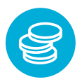


Habitat’s Traditional Model
Fimd
Fundraise Build 30-year
0% Mortgage
Is being hammered by larger market forces
Notes:
Our traditional model was launched in 1976. Fifty years later, that model does not produce success in the same way it used to.

Slide 14
Construction Costs: Skyrocketing
In the past decade:
Labor & materials costs up 56%*
Land costs up 60% to 300%*
House that cost $120,000 to build in 2012 now costs at least $190,000 and as much as $300,000 in some regions*
*Source: Habitat Capital
Notes:
I’m sure it’s not surprising to you, as you live and breathe this everyday, but it costs a lot more to build a house today than it did 10 years ago.

Slide 15
Government Funding: In Flux
Traditional federal resources uncertain (such as HOME, CDBG, SHOP, etc.)
Reduced staffing at HUD affecting agency responsiveness
Increased competition for state resources (such as IL Affordable Housing Tax Credits, IL Affordable Housing Trust Fund, local downpayment assistance programs, etc.)
Notes:
Even as costs are up, some of our long-utilized federal funding sources are not as reliable. We’ve seen cutbacks, or threatened cutbacks in many federal programs, as well as reduced staffing. In IL, this uncertainty has meant that we now see significantly increased competition for state resources, particularly the tax credit program. Prior to this past year, that program had never run out of the annual tax credit application. Now we have to be strategic in our submissions.

Slide 16
Skilled Labor: In Short Supply
Construction industry will need to attract 500,000 new workers in 2026 to meet expected demand*
Affiliates report skilled volunteers aging out & harder to replace
*Source: Associated Builders & Contractors
Notes:
On the people side, there is a shortage in skilled construction workers, creating increased cost and time to work with skilled trades. We’ve also heard may affiliates report that their regular construction volunteers – that crew of mostly retired men that shows up 1-2 days per week – is aging and aging out of construction work, and they are not seeing new retirees commit to the same level.

Slide 17
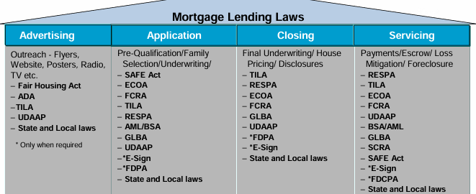
Mortgage Lending: Much More Complex
Affiliates face an alphabet soup of
compliance requirements
*Source: Habitat Capital
Notes:
Furthermore, in response to the fall of the housing market in the early 2000s, the Dodd-Frank bill was passed in 2013, requiring significantly more complex regulation of mortgages and closings. Gone are the days of meeting in the Habitat office to sign a few mortgage documents. Affiliates must now have a designated QLO, go through training, and ensure compliance with a long list of mortgage lending laws.

Slide 18
Habitat’s Traditional Model:
The Math Isn’t Adding Up
Higher costs mean affiliates must raise more $$ to build the same house, with the same staff
Traditional model: affiliates must raise funds for next home with little return from prior home sale
Difficult for affiliates to build more or make multi-year plans because all construction hinges on fundraising success
Notes:
I wanted to call this slide “The Math isn’t Mathing” but Dru overruled me. But I still think of it as the math isn’t mathing. You are doing the same or more work to build affordable housing, but the finish line has moved. You now have to raise more $$ to build the same house. And with our traditional model, you have always fundraised all the funds to build a home, sold it, and then had to start from scratch again to fundraise for the next home. With all the uncertainty in fundraising and building costs, it’s hard to be sure when you will have raised the amount you need, so you can’t make firm production plans. With all this complexity and uncertainty, it’s no wonder that we are struggling to meet this moment.

Slide 19
What Can We Do? Our Approach to the Problem

Slide 20
Chicagoland Efforts Since 2021
Researched ways to help affiliates increase production
Staff proposed exploring & piloting programs to
    Make full use of available government resources & advocate for policies that facilitate production and reduce costs
    Adopt innovative production methods
    Access & recycle capital faster
Board endorsed overall direction, but recommended prioritizing & narrowing focus

Slide 21
Key Research/Conversations to
Prioritize & Narrow Focus
Affiliates
Other Affiliate Support Organizations
HFHI/Habitat Capital
Community Development Financial Institutions
CDFI Consultants
Banking Partners
Affiliates Using Innovative Production Methods
Market Construction Companies using Modular Housing
Illinois Housing Development Authority
Federal Home Loan Bank of Chicago

Slide 22
Prioritizing & Narrowing Focus
POTENTIAL FOCUS: Make full use of available government resources & advocate for policies that facilitate production and reduce costs
ASSESSMENT:
Ramping up advocacy, but it’s the long game
Federal resources in flux
Higher demand for state resources
Zoning largely a local issue

Slide 23
Prioritizing & Narrowing Focus
POTENTIAL FOCUS: Adopt innovative production methods
ASSESSMENT:
Longer runway to impact
Many questions - is it proven technology, consistently available, financially viable, permissible under current codes?
Can be challenging to scale

Slide 24
Prioritizing & Narrowing Focus
POTENTIAL FOCUS: Access & recycle capital faster
ASSESSMENT:
Most promising right now
More immediate impact than other options
Relatively easy to replicate & scale
HFHI supports thoughtfully transitioning from traditional model

Slide 25
Accessing & Recycling Capital

Slide 26
Accessing Capital
Chicagoland explored becoming a CDFI, but did not see value-add beyond what’s already available in the marketplace
Illinois already has many CDFIs, making it harder to compete for federal CDFI Fund support
Affiliates already have options with HFHI’s Habitat Capital for both project and organizational borrowing

Slide 27
Accessing Capital
Zeroed in on mortgage strategies:
Mortgage Leveraging
Mortgage Sales
Third-party Originations
Attractive options because:
Relatively quick impact
Scalable and replicable
Can leverage existing products and partnerships

Slide 28
Recycling Capital: Mortgage Sales
Affiliate originates mortgage and sells to an investor; can sell new or seasoned loans; takes them off affiliate’s balance sheet
Affiliate may be able to retain or release servicing, depending on agreement with investor
Significant work for affiliate to
    Ensure loans are in good form and saleable
    Find investor willing to purchase
    Evaluate terms & obtain favorable pricing, often without experience in this area
Or can pay to engage consultant for transaction

Slide 29
Recycling Capital: Mortgage Leveraging
Affiliate originates & holds mortgages (stay on balance sheet); uses them as collateral for secured borrowing; can leverage new or seasoned loans
Affiliate retains servicing
Significant work for affiliate to
    Ensure loans are in good form and saleable
    Find lender willing to purchase
    Evaluate terms & obtain favorable pricing, often without experience in this area
Or can pay to engage consultant for transaction

Slide 30
Recycling Capital: Third-party Lending
Affiliate coordinates relationship & terms, but borrower obtains first mortgage directly from financial institution (only new loans)
Lender generally services mortgage
Borrower’s housing payment still capped at 30% of gross monthly income
Affiliate can provide soft second mortgage to bridge any resulting affordability gap
Often can be coupled with downpayment assistance programs

Slide 31
How Different Approaches Address Affiliate Goals: | Third-party Origination | Mortgage Sale | Mortgage Leveraging
Increase number of families served | X | X | X
Improve cash flow/ overall financial stability | X | X | X
Build stronger affiliate relationships with financial institutions | X | X | X
Ensure affiliate legal & regulatory compliance by using outside experts | X
Free up affiliate staff resources to focus on core competencies | X

Slide 32
Is this Right for Our Affiliate?

Slide 33
Recognize this is a Big Shift
for Habitat Affiliates
0% mortgages are integral to Habitat identity
Are we still Habitat if we don’t offer 0% mortgages?
But can we keep tying up significant capital in long-term mortgages in today’s operating environment and survive financially?
It’s a decision that requires thoughtful consideration
Notes:
If you haven’t used third party lending, we understand that this is a big decision. 0% mortgages have been one of our hallmarks. No doubt they are a great package for home buyers. Can’t be beat financially. a question we are probing here is can Habitat continue to offer them and thrive, or even survive?

Slide 34
Consider: Affiliate Finances
Trading small stream of long-term payments (consider time value of money) for immediate cash infusion to start next build
Does not replace fundraising; it’s part of larger, diversified funding strategy
Helps with production planning, which can strengthen case to funders
Notes:
As you consider third party lending, we know you will want to consider your finances, with traditional, get smaller payments steadily over time. With Third party, get one infusion at closing. This is not the end to your fundraising, but it’s a big boost. Also allows you to count on these infusions and plan.

Slide 35
Consider: Capacity & Staffing
Mortgage lending is costly, complex, and time-consuming – allows affiliate staff to focus on Habitat core competencies
Provides independent check that buyers have financial capacity for successful ownership
IMPORTANT NOTE: Per HFHI, each affiliate still must have a Qualified Loan Originator (QLO) even if going 100% third-party
Notes:
Another consideration is your staff and your capacity. Habitat affiliates perform a lot of functions. The more that can be outsourced well, the more time you have for core work. Also another set of eyes on buyer readiness. Still need QLO.

Slide 36
Consider: Partner Families
Opportunity for families to build banking relationships and credit profile
Removes inherent tension of affiliate being both support to family and mortgage lender
Affects full flexibility to address default situations
Home Buyer Education is key so families fully understand financing options
Notes:
Also consider partner families, long been a tension in being the good cop – helping family secure a home, and the bad cop – mortgage collector. It’s a tough dichotomy. This changes that dynamic and allows families to build banking relationships and credit. This will impact the full flex you have now to address default situations, but there are ways you can still step in.

Slide 37
Consider: Building Equity
Buyers build equity more slowly with third-party financing vs. traditional Habitat mortgage
Habitat soft second can be structured to mitigate impact of interest charges on equity growth in early years of mortgage
It’s a fact - traditional Habitat mortgages are amazing for buyers; unfortunately, network is struggling to sustain traditional mortgages
Third-party lending helps more buyers achieve homeownership and they do build equity
Notes:
Finally, you’ll consider equity. In a traditional model, home buyers build a significant amount of equity. That equity will be built more slowly with their party lending, as initial payments will typically apply to interest. That said, a soft second can be written/structured to provide more equity to the buyer.

Slide 38
Finding a Solution that Works for Affiliates

Slide 39
Mortgage Partnership Finance (MPF®)
Habitat for Humanity ® Program

Slide 40
We Heard Your Concerns
  The MPF-Habitat Program with the Federal Home Loan Bank of Chicago offers:
    Consistency
    Wide availability across IL & WI
    Flexible underwriting
    Reduced-interest rate

Slide 41
Program features
Allows FHLBank of Chicago members to sell Habitat loans to the FHLBank of Chicago through Mortgage Partnership Finance (MPF)
Interest rate approximately 250 basis points (2.5 percentage points) below market
No minimum borrower downpayment
580 minimum credit score
43% back-end debt ratio

Slide 42
Program features - continued
No PMI if first mortgage <90% LTV
Ability to layer with FHLB DPPA and other downpayment grants
105% CLTV with community seconds
Closing costs can be rolled into subordinate financing

Slide 43
Third-party Lending Example
Appraised Value/Purchase Price | $250,000
Monthly Principal & Interest Pmt. | $637.50
Mortgage | Habitat 0% | Market Rate | Reduced Rate
First Mortgage Interest Rate | 0% | 6.00% | 3.50%
First Mortgage Term (years) | 30 | 30 | 30
First Mortgage | $229,500 | $106,330 | $141,968
Habitat Soft Second Mortgage |  | $123,170 | $87,532
Downpayment Grants (estimate) | $20,000 | $20,000 | $20,000
Borrower Downpayment | $500 | $500 | $500
Total | $250,000 | $250,000 | $250,000
Cash to affiliate at closing | $20,500 | $126,830 | $162,468

Slide 44
High-cost Market - Price = $320,000 | 50% AMI | 60% AMI | 70% AMI
2025 HOME Income Limits (4-person household) | $ 59,950 | $ 71,940 | $ 83,930
Monthly Income | $ 4,996 | $ 5,995 | $ 6,994
30% of Monthly Income | $ 1,499 | $ 1,799 | $ 2,098
First Mortgage Payment | $ 789 | $ 1,089 | $ 1,293
Property Taxes | $ 510 | $ 510 | $ 510
Homeowners Insurance | $ 200 | $ 200 | $ 200
Total Monthly Payment | $ 1,499 | $ 1,799 | $ 2,003
First Mortgage (30 yrs/3.5%) | $ 175,651 | $ 242,403 | $ 288,000
Borrower Downpayment | $ 500 | $ 500 | $ 500
Downpayment Grants (estimate) | $ 20,000 | $ 20,000 | $ 20,000
LTV First Mortgage | 54.89% | 75.75% | 90.00%
Front-end Debt Ratio | 30% | 30% | 29%
Cash to affiliate at closing | $ 196,151 | $ 262,903 | $ 308,500
Affiliate Soft Second | $ 123,849 | $ 57,097 | $ 11,500

Slide 45
Lower-cost Market - Price = $175,000 | 50% AMI | 60% AMI | 70% AMI
2025 HOME Income Limits | $50,450 | $60,540 | $70,630
Monthly Income | $4,204 | $5,045 | $5,886
30% of Monthly Income | $1,261 | $1,514 | $1,766
First Mortgage Payment | $707 | $707 | $707
Property Taxes | $375 | $375 | $375
Homeowners Insurance | $100 | $100 | $100
Total Monthly Payment | $1,162 | $1,182 | $1,182
First Mortgage (30 yrs/3.5%) | $157,500 | $157,500 | $157,500
Borrower Downpayment | $500 | $500 | $500
Downpayment Grants (estimate) | $17,000 | $17,000 | $17,000
LTV First Mortgage | 90.00% | 90.00% | 90.00%
Front-end Debt Ratio | 28% | 23% | 20%
Cash to affiliate at closing | $175,000 | $175,000 | $175,000

Slide 46
Is this Right for Our Community?
Notes:
We will pivot to questions after this, but wanted to bring the conversation back to the larger national conversation, and the part of it that is happening in your backyard.

Slide 47
Why Move to Third-party Lending?
Provides strong, dependable return on home sale which is seed funding to start next build
Gives affiliate confidence to commit to timeline for next house vs. having to wait to start until funds are raised
Enables affiliate to plan production proactively vs. waiting for fundraising to plan
Notes:
One of the key benefits of third part is that it provides a dependable source of funds that can jumpstart the next Habitat home. Can plan

Slide 48
Why Move to Third-party Lending?
Having multi-year plan creates a better case for fundraising and grant applications
Which offers greater stability, particularly given major uncertainty with government funding
Also relieves affiliates of burdensome mortgage compliance duties, freeing bandwidth to focus on core mission activities
Notes:
When you can commit to the next home, you can talk to donors and stakeholders with a better timeline. And if you’re able to build more homes, that strengthens your fundrasiign case. With dependable funding, not as reliant on govt funds. Opens bandwidth.

Slide 49
Meeting this Moment
Dependable funding stream, combined with affiliate fundraising, can enable affiliates to sustain operations and serve more families
Our neighbors, our communities, our states need more affordable homes – this is Habitat’s mission
We must do all we can,
and explore every option,
to serve those in need
Notes:
The hope, with all this, is that we can better meet the moment. Our vision is that everyone has a decent place to live. If we believe that, we must do everything we can to leverage our resources to help as many families as possible.

Slide 50
Questions?

Slide 51
This is big – but you’re not alone
Your ASOs are here to help! We can
Meet with your board & staff
Model options for your market
Connect you with a Participating Financial Institution
Provide technical assistance
Relay your feedback

Slide 52
For more information
IL Affiliates: contact Dru Bergman dru.bergman@chicagolandhabitat.org
WI Affiliates: contact Peter Lewandowski plewandowski@habitatwisconsin.org

